Slide 1

DESIGN OF ACCESS CHECK FRAMEWORK FOR MEDICARE SYSTEM
MORRIS DARREN B - 211718104087
KARTHIKEYAN M - 211718104060
IV-B
UNDER THE GUIDANCE OF
Dr. D.C Joy Winnie Wise
Head Of The Department
Computer Science Engineering, RIT.
19/03/2022
Department of Computer Science and Engineering
Batch No:23

Slide 2
ABSTRACT
Historic libraries are known to contain flaws introduced during the digitization process by OCR (optical character recognition) methods, which are typically blamed for reducing the performance of NLP systems.
Manually correcting these inaccuracies is a time-consuming operation, many automatic alternatives rely on rules or unsupervised machine learning and extend prior work on fully automatic unsupervised parallel data extraction to train a character-based sequence-to-sequence NMT (neural machine translation) model for English OCR mistake correction.
The proposed algorithm is based on Google’s online spelling suggestion which harnesses an internal database containing a huge collection of terms and word sequences gathered from all over the web, convenient to suggest possible replacements for words that have been misspelled during the OCR process.
Experiments carried out revealed a significant improvement in OCR error correction rate.
19/03/2022
Rajalakshmi Institute of Technology
2

Slide 3
INTRODUCTION
The process of OCR is most commonly used to turn hard copy legal or historic documents into PDFs. Once placed in this soft copy, users can edit, format and search the document as if it was created with a word processor.
The first step of OCR is using a scanner to process the physical form of a document. Once all pages are copied, OCR software converts the document into a two-color, or black and white, version.
Practically, the error rate of OCR systems can fairly become high, occasionally close to 10%, the commonly used solutions for errors in OCR are Pattern recognition and Feature detection.
19/03/2022
Rajalakshmi Institute of Technology
3

Slide 4
MOTIVATION
To eliminate most of the errors in OCR converted image or document
To achieve automatic error correction of words in documents by post-processing techniques.
To improve efficiency and accuracy of the model.
19/03/2022
Rajalakshmi Institute of Technology
4

Slide 5
CHALLENGES
Complicated and tricky to implement securely, mainly the post-processing technique.
The character identification with blurred image is difficult for pre-processing in OCR conversion.
19/03/2022
Rajalakshmi Institute of Technology
5

Slide 6
Literature Review
NAME OF THE AUTHOR | MONTH AND YEAR OF PUBLICATION | NAME OF THE JOURNAL/CONFERENCE | ABSTARCT
Anjali T, Khurram Shahzad, Muhammad Kamran Malik | APRIL 2021. | Towards End-to-End Urdu Text Recognition Using Deep Learning | Urdu is a prominent South Asian language and a number of different solutions for Urdu OCR have been proposed and has a very large Multi-level and Multi-script Urdu corpus (MMU-OCR-21). It is the largest-ever Urdu corpus of printed text that is effectively suitable to work with deep learning techniques. In total, the corpus is composed of over 602,472 images, including text-line and word images in three prominent fonts, and their respective ground truth.
19/03/2022

Slide 7
Literature Review
NAME OF THE AUTHOR | MONTH AND YEAR OF PUBLICATION | NAME OF THE JOURNAL / CONFERENCE | ABSTARCT
Khurram Shahzad, Muhammad Kamran malik. | JANUARY 2019 | Handwritten Optical Character Recognition (OCR):A Comprehensive Systematic Literature Review (SLR) . | This paper describes the results of a statistical analysis of OCR errors on four document collections. Five aspects related to general OCR errors are studied and compared with human-generated misspellings, including edit operations, length effects, erroneous character positions, real-word vs. non-word errors, and word boundaries. Based on the observations from the analysis we give several suggestions related to the design and implementation of effective OCR post-processing approaches.
19/03/2022

Slide 8
Literature Review
NAME OF THE AUTHOR | MONTH AND YEAR OF PUBLICATION | NAME OF THE JOURNAL / CONFERENCE | ABSTARCT
Adam Jatowt, Antoine Doucet. | FEBRUARY 2018 | Post-OCR Error Detection by Generating Plausible Candidates | Post-processing approaches detect and correct remaining errors to improve the quality of OCR texts. In this paper, we describe a novel error detector using different features from character-level (including character noisy channel, index of peculiarity) to word-level (such as frequencies of n-grams, skip-grams, part-of-speech) Experimental results show that our approach outperforms the best performing techniques in the ICDAR 2017 Competition on Post-OCR text correction.

Slide 9
REQUIREMENTS
HARDWARE
Processor: Minimum 2.4 GHz; Recommended 3GHz or more.
Internet: Ethernet connection (LAN) OR a wireless adapter (Wi-Fi)
Hard Drive: Minimum 250 GB; Recommended 500 GB or more.
Memory (RAM): Minimum 8 GB; Recommended 16 GB or above.
SOFTWARE
Front End : JAVASCRIPT, HTML, CSS
Programming Language: Python
Operating System: Windows 7 or higher
IDE: VS code Platform
19/03/2022
Rajalakshmi Institute of Technology
9

Slide 10
EXISTING MODEL
Some of the examples of the already existing OCR correction techniques are:
Manual Error correction
Intuitively, the easiest way to correct OCR errors is to hire a group of people to sit down and try to edit the OCR output text manually.
Dictionary-Based Error Correction
In this approach, a lexicon or a lookup dictionary is used to spell check OCR recognized words and correct them if they are misspelled. In some cases, a list of passes. On every pass, a spell checker tool intervenes to detect and correct misspelled words.
Context-Based Error Correction
Hypothetically, dictionary-based error correction techniques are reasonably plausible and successful. Context-based error correction techniques, on the other hand, perform error detection and correction based on the error grammatical and sometimes semantic context.

Slide 11
PROPOSED MODEL
Concept
This project proposes a new post-processing method and algorithm for OCR error correction based on the “did you mean” spelling suggestion feature of Google’s online web search engine. The idea centers on using Google’s massive indexed data to detect and correct misspelled words in the OCR output text.
Algorithm
The actual correction consists of replacing the original block in the OCR output text by the Google’s alternative suggested correction is a variation of the generic OCR system proposed as algorithm, however, upgraded with an additional post-processing layer using the proposed error correction algorithm.
19/03/2022
Rajalakshmi Institute of Technology
11

Slide 12
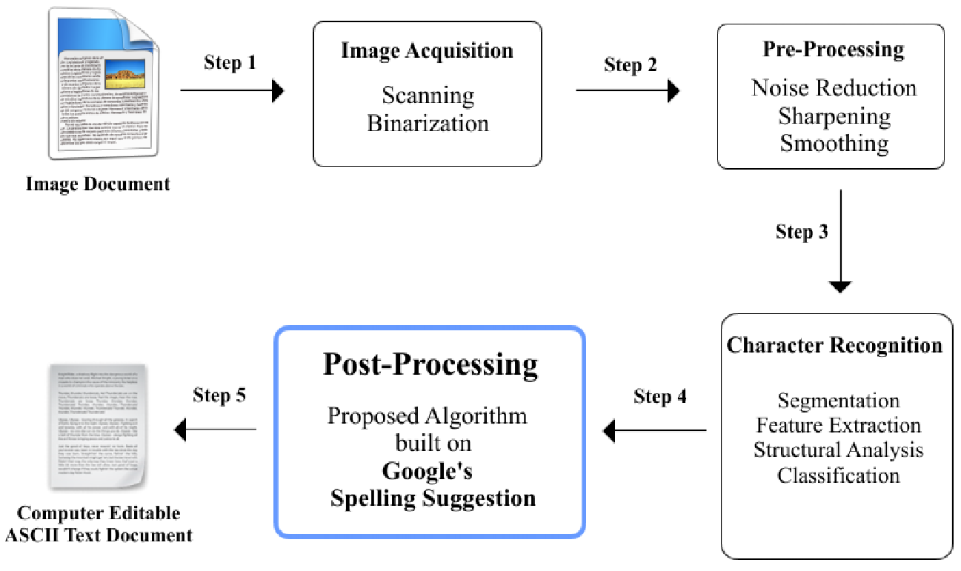
SYSTEM ARCHITECTURE
19/03/2022
Rajalakshmi Institute Technology

Slide 13
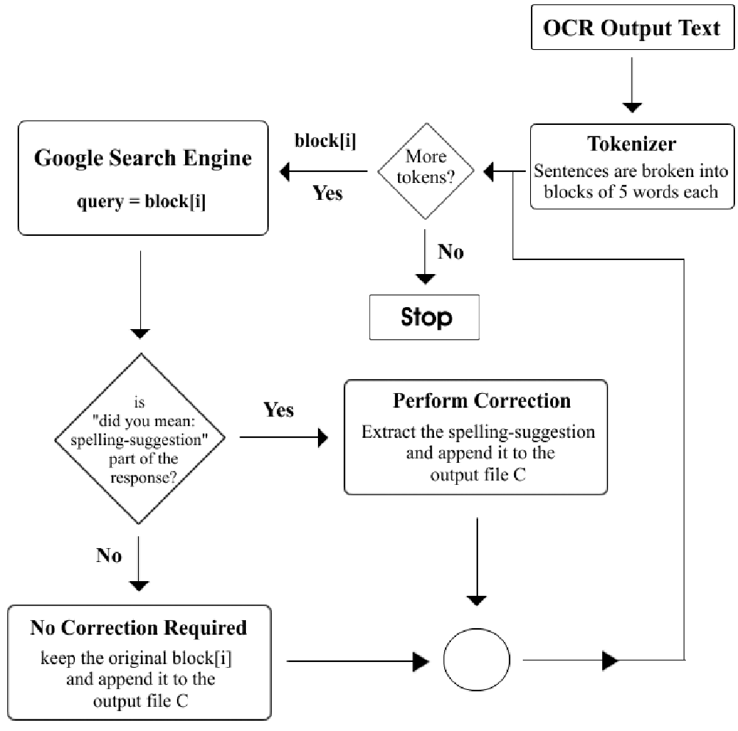
PROPOSED ALGORITHM DIAGRAM
19/03/2022
Rajalakshmi Institute of Technology
13

Slide 14
MODULES
MODULE DESCRIPTION:
Image acquisition
This involves scanning a document and storing it as an image on which recognition has to be performed.
Pre-Processing
We cannot input an image directly for the OCR system. Some pre-processing has to be done on the image so that it becomes moderately easy for OCR to recognize the information in the image.
Segmentation
Once a Clean image is obtained, after the Preprocessing stage, the next stage is the Segmentation. It is a technique of breaking the whole image into subparts to further process them.
19/03/2022
Rajalakshmi Institute of Technology
14

Slide 15
MODULES
Feature Extraction
In this phase, we extract some Unique Features of the segmented subcomponents obtained from the previous stage.
Classification
This is the decision-making stage of an OCR system. Classification uses the features extracted in the feature extraction stage to identify the text segment in the uploaded document or image.
Post-processing
In the majority of the cases, these prediction errors will result in small spelling mistakes because of the wrong prediction of one or two letters in a word (like the word ‘ball’ is predicted as ‘boll’). So these types of spelling mistakes can be corrected using Google’s Spelling Suggestion.
.
19/03/2022
Rajalakshmi Institute of Technology
15

Slide 16
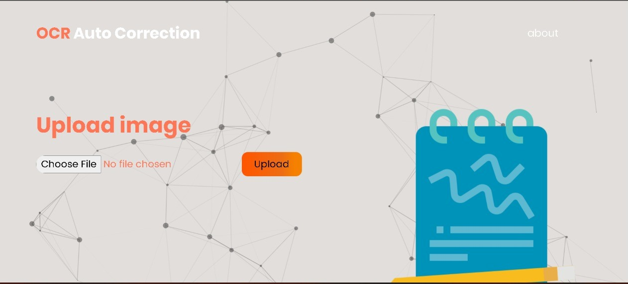
Model User Interface
19/03/2022
Rajalakshmi Institute of Technology
16

Slide 17
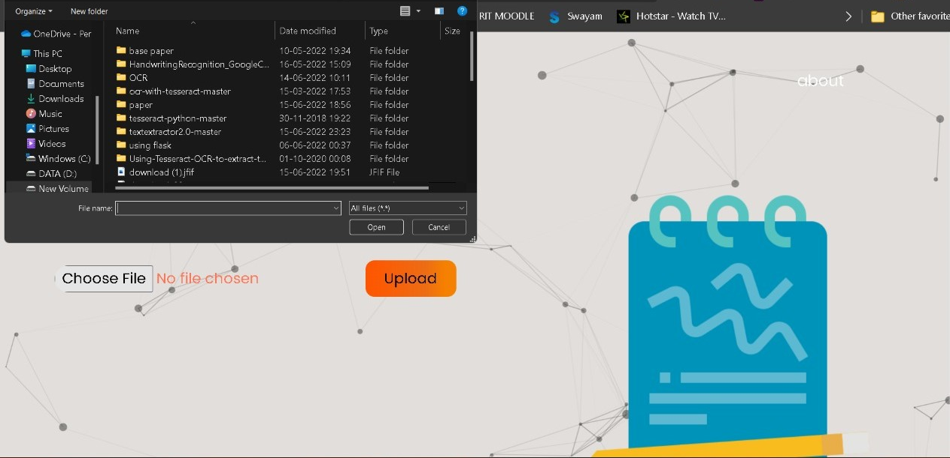
Upload section
19/03/2022
Rajalakshmi Institute of Technology
17

Slide 18
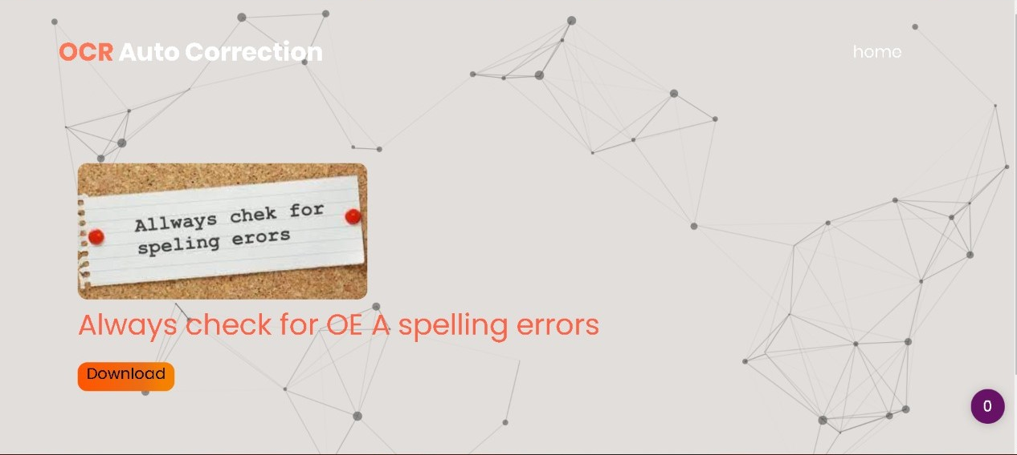
Model Output
19/03/2022
Rajalakshmi Institute of Technology
18

Slide 19
References
[1] A. Sinha, M. Jenckel and S.S. Bukhari, "Unsupervised OCR Model Evaluation Using GAN," 2019 International Conference on Document Analysis and Recognition (ICDAR), 2019, pp. 1256-1261, doi: 10.1109/ICDAR.2019.00-42.
[2] A.T. Sahlol, M.A.A. Al-Qaness and M.Abd Elaziz S. Kim, "Handwritten Arabic Optical Character Recognition Approach Based on Hybrid Whale Optimization Algorithm With Neighborhood Rough Set," in IEEE Access, vol. 8, pp. 23011-23021, 2020, doi: 10.1109/ACCESS.2020.2970438.
[3]A. Sachan and H. Singh, "A Proposed Approach for Character Recognition Using Document Analysis with OCR," 2018 Second International Conference on Intelligent Computing and Control Systems (ICICCS), 2018, pp. 190-195, doi: 10.1109/ICCONS.2018.8663011.
[4] H. Fang and M. Bao, "Raw material form recognition based on Tesseract-OCR," 2021 IEEE Conference on Telecommunications, Optics and Computer Science (TOCS), 2021, pp. 942-945, doi: 10.1109/TOCS53301.2021.9688701.
19/03/2022
Rajalakshmi Institute of Technology
19

Slide 20
References
[5]J. Memon, M. Sami, M. Uddin and R.A. Khan, "Handwritten Optical Character Recognition (OCR): A Comprehensive Systematic Literature Review (SLR)," in IEEE Access, vol. 8, pp. 142642-142668, 2020, doi: 10.1109/ACCESS.2020.3012542.
[6] K. Woo, "Improving OCR Accuracy on Images with Motion Blur via GAN Derivatives," 2020 IEEE MIT Undergraduate Research Technology Conference (URTC), 2020, pp. 1-4, doi: 10.1109/URTC51696.2020.9668859.
[7] M.K. Malik, K. Shahzad andT. Nasir, "MMU-OCR-21: Towards End-to-End Urdu Text Recognition Using Deep Learning," in IEEE Access, vol. 9, pp. 124945-124962, 2021, doi: 10.1109/ACCESS.2021.3110787.
[8] N. Chigali, K. Suvarna Vani, S. Rajeswari and S.R. Bobba, "OCR Assisted Translator," 2020 7th International Conference on Smart Structures and Systems (ICSSS), 2020, pp. 1-4, doi: 10.1109/ICSSS49621.2020.9202034.
19/03/2022
Rajalakshmi Institute of Technology
20

Slide 21
Thank You
19/03/2022
Rajalakshmi Institute of Technology
21

